Slide 1
Leaf Classification
Identifying plant species by the characteristics of their leaves
Author: Zach Stecher

Slide 2
Project Details
Objective: Find a machine learning solution to the problem of classifying plant species based on pictures of their leaves.
Participants were supplied with a training and testing data set, as well as pictures of each leaf.
The objective was to find a combination of classifier and data attributes that could accurately predict a plant’s species based on the shape of its leaf.
Score determined by submission’s Log Loss. Better scores approach zero.

Slide 3
Why this project?
A decent introduction to image recognition applications of artificial intelligence.
A chance to explore algorithms not covered in class
Possible applications
Crop management
Medical practice in areas without ready access to modern medicine
Easier environmental tracking and impact study

Slide 4
Methods
Ran a classifier comparison program available on the Kaggle competition forum.
This provided a solid starting idea of which classifiers performed and which weren’t worth looking at.
Also attempted to run TensorFlow and Theano.
Had to fall back on RandomForest as a benchmark when TensorFlow and Theano did not pan out due to technical issues.
Picked two classifiers from the comparison to go against RandomForest to find the most promising of the three.

Slide 5
Classifiers
Tried KNeighborClassifier and Linear Discriminant Analysis as they provided the best initial scores.
RandomForest generated the best score of the three “out of the box”.
Attempted to tune Kneighbor and LDA to beat RandomForest’s initial score.
After both classifiers failed to beat RandomForest, I decided to try and get the best score with RandomForest.

Slide 6
What is Random Forest?
An ensemble learning algorithm
Utilizes multiple “decision tree” classifiers
Randomly assigns each of these decision tree classifiers a portion of the data, but never all of it.
Also randomizes which attributes are considered at which trees, to avoid giving too much weight to possibly irrelevant attributes
Averages the responses from every decision tree classifier to come up with an answer

Slide 7
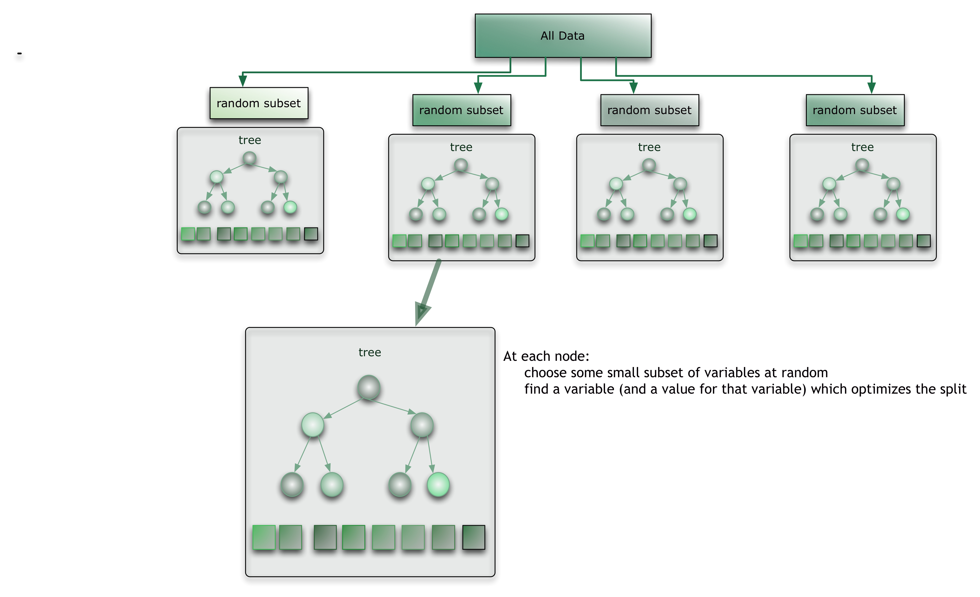

Slide 8
Experiments
Tried two different RandomForest implementations and compared their results at the same number of trees
One implementation utilized Stratified Shuffle Split cross validation, while the other did not utilize cross validation at all

Slide 9
Results
Best score achieved by KNeighbors: 1.63982
Best score achieved by LinearDiscriminationAnalysis: 1.24583
Best score achieved by RandomForest with Cross Validation: 0.77641
Multiple runs at differing numbers of trees all achieved results between 0.77641 and ~0.78000
Best score achieved by RandomForest without CV: 0.67886
Multiple runs at differing numbers of trees all achieved results between 0.67886 and ~0.68500

Slide 10
Observations
RandomForest seems to be the best jumping off point for this problem due to it’s resistance toward providing undue weight to irrelevant features. This is especially important in image recognition where features may vary in importance from image to image.
RandomForest also seems to be highly resistant to overfitting, as once overfitting DID begin at high tree levels, the accuracy on the test data decreased very slowly.
Feature selection is much more important than I initially thought and is likely the biggest reason I could not get my best score lower.

Slide 11
In The Future
Would still like to try a proper neural network on this problem.
Especially fix technical issues with TensorFlow and Theano and try them
Other submissions dabbled with things like Keras Neural Networks and feature extraction from the images themselves rather than the provided .csv data set.
With enough time, would be interesting to see if proper feature choice and attribute tuning on unexpected classifier would yield better results

Slide 12
References
http://scikit-learn.org/stable/modules/generated/sklearn.ensemble.RandomForestClassifier.html
https://citizennet.com/blog/2012/11/10/random-forests-ensembles-and-performance-metrics/
https://www.kaggle.com/c/leaf-classification
https://www.kaggle.com/jeffd23/leaf-classification/10-classifier-showdown-in-scikit-learn
https://www.kaggle.com/sunnyrain/leaf-classification/random-forests-with-0-68-score

Slide 13
Questions?
Examples:
Why are the Jets terrible this year?
Did you watch the Westworld finale?
How many support vectors does it take to change a light bulb?

